Slide 1

Accounting Information System
2
Day
#1
Chapter
UAA – ACCT 201 Principles of Financial Accounting Dr. Fred Barbee

Slide 2
Chapter 2 - Day 1 - Agenda
Topic | LO | Read | HW
Generally Accepted Accounting Principles | C1, C2 | 38-41 | QS1, E1
Transactions, Documents, and the Accounting Equation | C3, C4, C5 | 41-46 | QS2, QS3
Transaction Analysis and the Accounting Equation | A1 | 46-52 | E3

Slide 3
FUN
derstanding
FUN
tastic
FUN
ancial
IS FUN!
Accounting
ACCOUNTING
Dr = Cr

Slide 4

How do you . . .
. . . Eat an elephant?

Slide 5

Learning Accounting
If you want to learn accounting, you learn it one concept at a time, one principle at a time.

Slide 6
Accounting Information System
2
Chapter
Text Section: Generally Accepted Accounting Principles (p. 38)

Slide 7


Learning Objective
C1
  Explain the financial reporting environment
Conceptual

Slide 8
The Accounting System:
A Conceptual Overview
Operating Environment
Entity B
Entity C
Business Entity A
System Inputs:
Measurable
Transactions
and Events
Process and
Summarize
System Outputs:
Financial
Statements
and Reports
Entity D
Entity E

Slide 9








Financial Reporting Environment
FASB
GAAP
Financial
Statements
Preparers
Audit
Report
Decision makers
Auditors
ASB
GAAS
Notes:
16

Slide 10

Independent Auditor
Management
Management Prepares
1
A
3
A
P
Income Statement
G
Balance Sheet
Auditors
S
Statement of Cash Flows
G
A
A
Lends Credibility
Basic Mistrust
Users
4
2

Slide 11

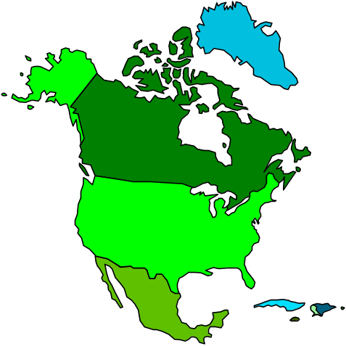

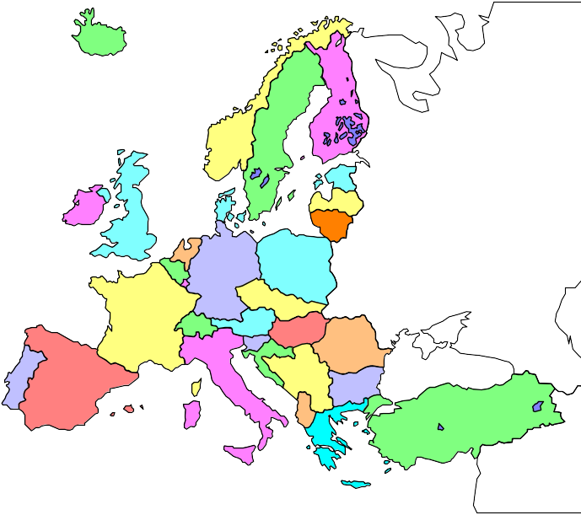
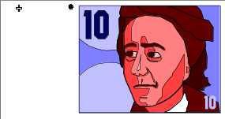

International Accounting Principles
Despite our growing global economy, countries continue to maintain their unique set of acceptable accounting practices.

Slide 12
Learning Objective
C2
  Identify, explain, and apply accounting principles.
Conceptual

Slide 13
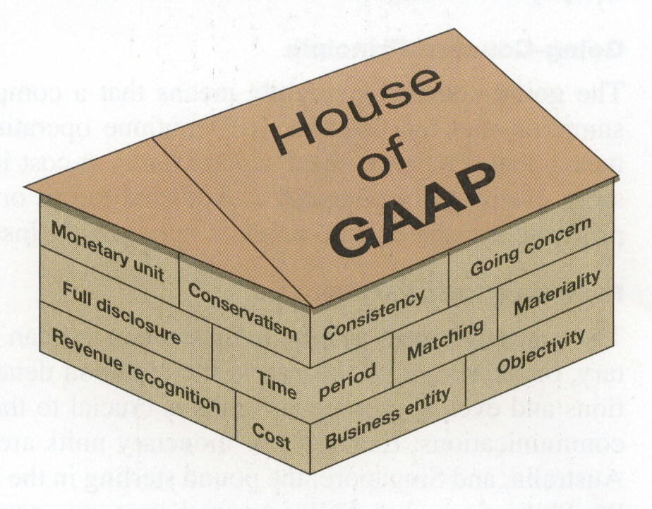
A business continues operation instead of being closed or sold.
Financial Statement information is supported by independent, unbiased evidence.
A business is accounted for separately from its owner(s).

Slide 14
Express transactions and events in monetary units.
Financial statements are based on actual costs incurred in business transactions.

Slide 15
Accounting Information System
2
Chapter
Text Section: Transactions, Documents, and Accounts (p. 41)

Slide 16
Learning Objective
C3
  Identify, explain, and apply accounting principles.
Conceptual

Slide 17




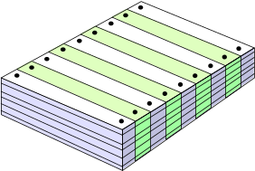

The Accounting Process
Exh.
2.2
Source documents
Transaction or event
Analysis
Reporting
Trial balance
Recording & posting

Slide 18



Transactions and Events
  Exchanges of economic consideration between two parties.
External Transactions occur between the organization and an outside party.
Internal Transactions occur within the organization.

Slide 19
Accounting Information System
Ongoing events in world
Boundary
Recording
Data Bank
Information
Classifying

Slide 20
Learning Objective
C4
  Describe source documents and their purpose.
Conceptual

Slide 21

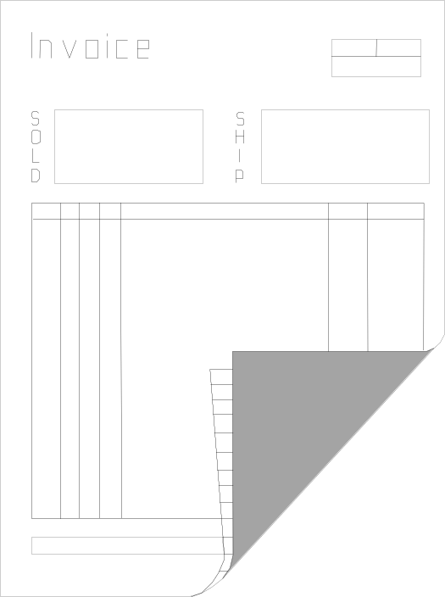



Source Documents
Other
Invoices
Bank Statement
Journal
Check Stubs

Slide 22
Learning Objective
C5
  Describe an account and its uses in recording transactions.
Conceptual

Slide 23
Account
A storage unit used to classify and summarize money measurements of business activity of a similar nature.

Slide 24

The Account
Detailed record of increases and decreases in specific assets, liabilities, equities, revenues, or expenses.
=======================
Separate accounts are maintained for each item of importance.

Slide 25

Asset Accounts
Cash
Supplies
Inventory
Accounts Receivable

Slide 26
Liability Accounts
Accounts
Payable
Mortgage
Payable
Notes
Payable
Accrued
Liabilities

Slide 27
Equity Accounts
For Sole
Proprietorships
and Partnerships
Owner(s)
Capital
Owner(s)
Drawing
Revenues
Expenses

Slide 28
Equity Accounts
For
Corporations
Common
Stock
Retained
Earnings
Revenues
Expenses
Dividends

Slide 29

The General Ledger
Accts Rec.
Inventory
General Ledger
Cash
A
Notes Pay.
Revenue
Mortgage
Expenses
Accts Pay.
Retained Earnings
=
+
SE
L

Slide 30
T Accounts
ACCT 201 ACCT 201 ACCT 201

Slide 31

Account Title
Left Side
Right Side

Slide 32
The Formal Account
The Balance Column Ledger

Slide 33
The Formal Account
Account Title |  |  |  |  | Account No. ###
Date |  | Item | Post Ref | Debit | Credit | Balance
 |  |  |  |  |  | Debit | Credit

Slide 34
Accounting Information System
2
Chapter
Text Section: Transactional Analysis and the Accounting Equation (p. 46)

Slide 35
Learning Objective
A1
  Analyze business transactions using the accounting equation.
Analytical

Slide 36
Assets
Liabilities
Owners’
Equity
=
+
Capital
Stock
Retained
Earnings
The Accounting Equation
A = L + OE
Revenue
Expenses
-
=
Net
Income

Slide 37
Analyzing Transactions
Analyze the transaction and its source.
Identify the impact of the transaction on account balances.
Identify the financial statements that are impacted by the transaction.

Slide 38
Transaction Analysis – Part 1 (Text p. 47)
On December 1, Chuck Taylor forms an athletic shoe consulting business. He sets it up as a corporation. Taylor owns and manages the business. The marketing plan for the business is to focus primarily on consulting with sports clubs, amateur athletes and others who place orders for athletic shoes with manufacturers.

Slide 39
Transaction Analysis – Part 1 (Text p. 47)
Taylor personally invests $30,000 cash in the new company in exchange for common stock, and deposits the cash in a bank account opened under the name of FastForward, Inc.

Slide 40
Transaction Analysis – Part II (Text p. 50)
To illustrate how revenue recognition works, let’s return to FastForward’s transactions.

Slide 41
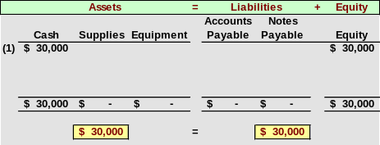
Chuck Taylor invests $30,000 in the company in exchange for common stock.
1
Notes:
21

Slide 42
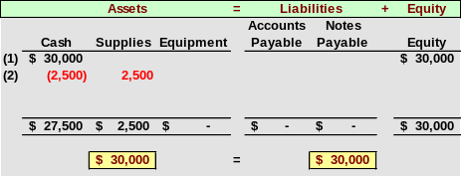
FastForward purchases $2,500 of supplies for cash.
2
Notes:
21

Slide 43
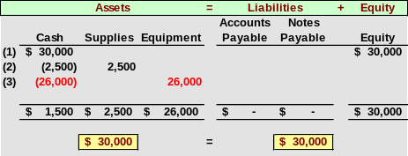
FastForward spends $26,000 to acquire equipment for testing athletic shoes.
3
Notes:
21

Slide 44
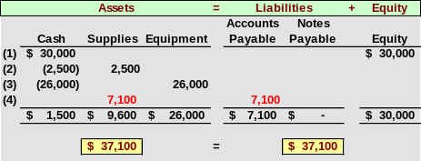
4
FastForward purchased $7,100 of supplies on credit.
Notes:
21

Slide 45
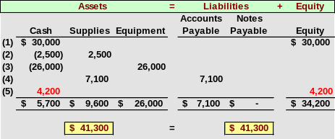
FastForward provides consulting services to an athletic club and collects $4,200 in cash.
5
Notes:
21

Slide 46
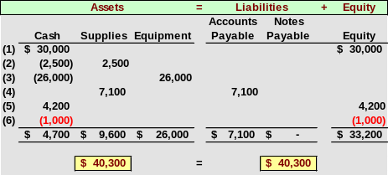
FastForward pays $1,000 rent to the landlord of the building where its store is located.
6
Notes:
21

Slide 47
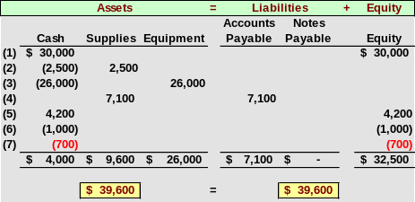
FastForward pays the biweekly $700 salary of the company’s only employee.
7
Notes:
21

Slide 48
Revenue Recognition Principle
Revenue is recognized when earned.
Assets received from selling products and services need not be in cash.
Revenue recognized is measured by the cash received plus the cash equivalent (market) value of any other assets received.

Slide 49
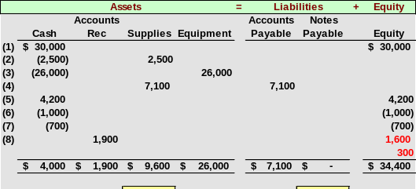
FastForward provides consulting services of $1,600 and rents its test facilities for $300.
8
Notes:
21

Slide 50
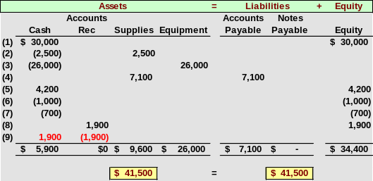
The client in transaction 8 pays $1,900 to FastForward 10 days after it is billed for consulting services.
9
Notes:
21

Slide 51
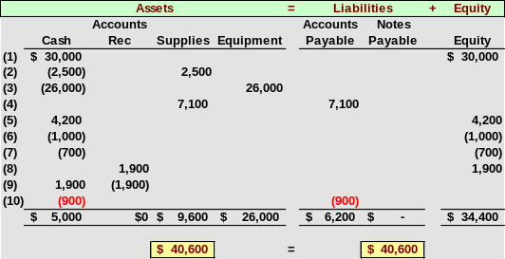
FastForward pays $900 to CalTech Supply as partial payment for its earlier $7,100 purchase of supplies.
10
Notes:
21

Slide 52
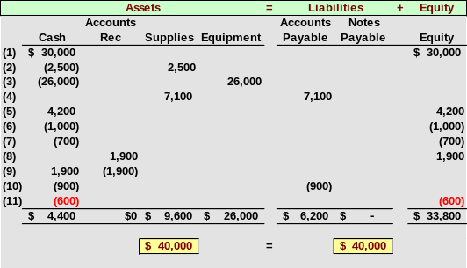
FastForward declares and pays a $600 cash dividend to its owner.
11
Notes:
21

Slide 53
Cash
(1) | 30,000
(5) | 4,200
(9) | 1,900
 | 36,100
 | -31,700
 | 4,400
(2) | 2,500
(3) | 26,000
(6) | 1,000
(7) | 700
(10) | 900
(11) | 600
 | 31,700
Increases
Decreases
Balance
Decreases

Slide 54
Cash |  |  |  |  | Account No. 101
Date |  | Item | PR | Debit | Credit | Balance
 |  |  |  |  |  | Debit | Credit
(1) |  |  |  | 30,000 |  | 30,000
(2) |  |  |  |  | 2,500 | 27,500
(3) |  |  |  |  | 26,000 | 1,500
(5) |  |  |  | 4,200 |  | 5,700
(6) |  |  |  |  | 1,000 | 4,700
(7) |  |  |  |  | 700 | 4,000
(9) |  |  |  | 1,900 |  | 5,900
(10) |  |  |  |  | 900 | 5,000
(11) |  |  |  |  | 600 | 4,400

Slide 55

“One must learn by doing the thing; though you think you know it, you have no certainty until you try it.”
Publilius Syrus, Moral Sayings

